Slide 1

“Quality in Every Drop”
Data Insights into Wine Excellence
Presented By;
Florence Braut
15/12/2024
Exam Project Scenario.pptx

Slide 2
AGENDA
Introduction
Purpose of analysis and overview of the dataset.
Key Insights
Distribution of wine quality.
Trends and patterns in wine quality.
Data Visualizations
Attribute correlations.
Alcohol content vs. quality.
Recommendations
Actionable strategies for production and marketing.
Design Thinking Process
Overview of principles and steps in designing this presentation.
Conclusion
Summary of findings and next steps.
Quality distribution.

Slide 3
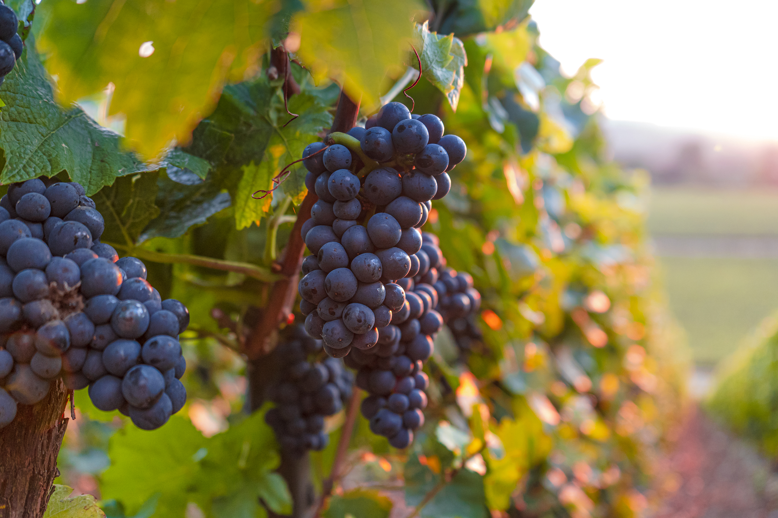
Introduction
Purpose:
This presentation leverages data insights to evaluate wine quality and provide actionable strategies for optimizing product standards and market performance.
Background Information:
The dataset includes over 1,357 samples of wine, analyzing factors like acidity, sugar, pH, alcohol and more content that influence quality ratings.
Quality ratings range from 3 (low) to 8 (high).
Key Objective:
Our goal is to identify trends and correlations to improve production and marketing strategies, focusing on higher-rated wines.

Slide 4
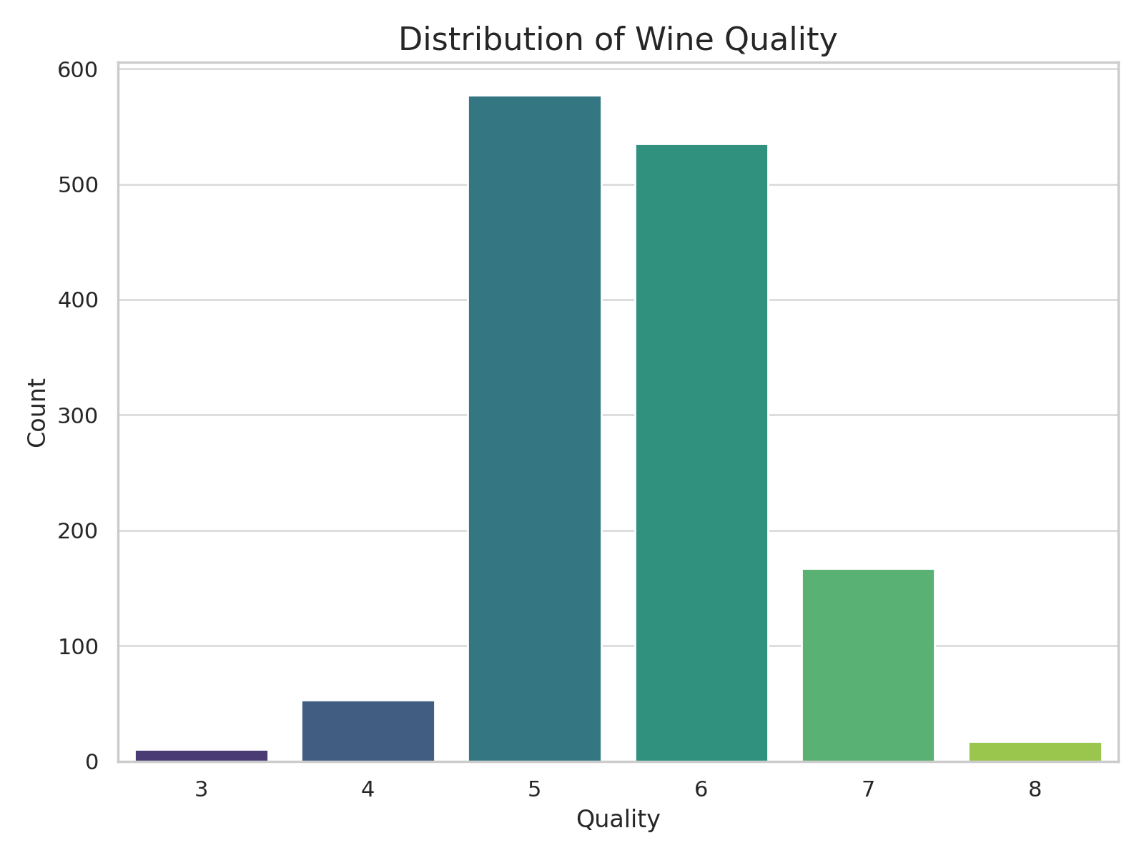
Distribution of Wine Quality
Trends or Patterns
Ky Insight
Introduction:
This chart shows the distribution of wine quality ratings based on our dataset.
As you can see, most of our wines fall within the 5 and 6 range, which represents average quality. This is a strong foundation, but there are clear opportunities to elevate the quality of our offerings.
key insights :
The data reveals that there is a smaller part of wines rated 7 and above. While this is a good indicator that we have some premium wines, we could aim to increase this segment further.
Low-quality wines (ratings 3-4) are quite rare, which is positive, but it does suggest that we have room to improve certain wines.

Slide 5
Correlation Between Attributes
This visual demonstrates how different wine attributes relate to one another and to wine quality, Strong correlations are key areas to focus on.
Attributes with Strong Correlations to Quality:
Alcohol: Positive correlation (+0.48) indicates higher alcohol content improves quality.
Volatile Acidity: Negative correlation (-0.39) suggests higher acidity lowers quality.
Relationships, e.g., "We see that alcohol content is one of the strongest predictors of quality, shown by its significant positive correlation with quality

Slide 6
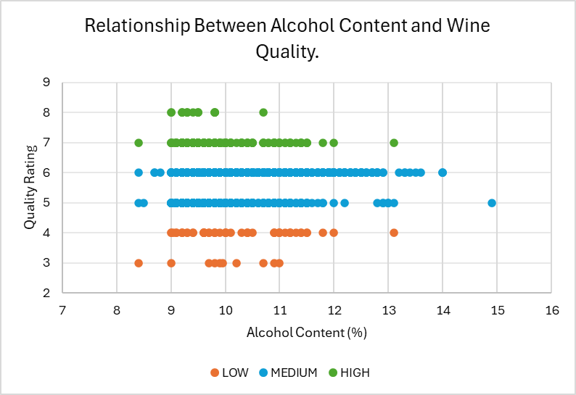
Relationship Between Alcohol Content and Wine Quality
KEY POINTS
Wines with higher alcohol content tend to score better in quality ratings. Notice how the green dots cluster in the 6–8 range.
Medium-quality wines (in blue) are spread across a wide alcohol range, with no distinct clustering.
Wines with low alcohol content (below 10%) tend to have lower quality ratings (in orange).
REMARK
While alcohol content plays a role in perceived quality, it's clear that other characteristics also contribute to a wine's overall rating.

Slide 7

Recommendations for Improving Wine Quality and Business Outcomes
Maximizing Alcohol Content:
Aim to produce wines with 11-13% alcohol content to achieve higher quality ratings, as indicated in slide 6.
Focus on Medium-Quality Segment:
Expand production and marketing efforts for medium-quality wines (scores 5-6), as they dominate the dataset and cater to a broad consumer base.
Target Premium Market:
Develop a strategy for high-quality wines (scores 7-8) to enter premium segments and maximize profits from High-value customers.
Improve Quality for Low-Scoring Wines:
Reassess production practices for low-quality wines (scores 3-4) to reduce losses or reposition them for cost-conscious consumers.
Monitor Acidity Levels:
Evaluate acidity and other factors alongside alcohol content to ensure balanced wine profiles, enhancing customer satisfaction.
Continuous Monitoring:
Regularly monitor and analyse wine samples to ensure that the physicochemical properties remain within the optimal range for high quality

Slide 8


Design Thinking and Principles in Presentation Design
Design Thinking Steps
Design Principles
To design this presentation, I followed a structured approach inspired by design thinking. Here’s how;
Empathize: Identified the board members as non-technical stakeholders needing simple, visually appealing insights.
Define: Focused on the key problem (alcohol content's effect on quality).
Ideate: Brainstormed multiple visualization options (scatterplots, bar chat,……….) to identify the most impactful.
Prototype: Created initial visualizations with Excel, testing different color codes and layouts.
Test: Iterated on visuals based on clarity and alignment with the audience's needs.
Clarity:
Kept visualizations simple, with clear axes, labels, and a consistent color scheme (Low = Orange, Medium = Blue, High = Green).
Focus on Key Insights:
Highlighted important trends.
Summarized findings in concise, easy-to-read bullet points.
Aesthetic Consistency:
Used a unified font style (Aptos, Gothic) and color palette throughout the slides.
Balanced visuals and text.
Hierarchy:
Used slide titles, bold headers, and bullet points to guide the audience's focus.
Audience-Centric Design:
Avoided technical details; instead, emphasized actionable insights and business implications.

Slide 9
Image Descriptions
Human Head and Brain (Flipping Horizontal and changing from black to white).
Flipping the brain image reflects our ability to approach problems from a new angle,
While the lightbulb Symbolizes insights and innovative ideas derived from applying design principles.
The vineyard connects the audience immediately to the theme of the presentation: wine production.
Keep the transparency so that it doesn’t distract the text AND The color transition (black to white) symbolizes clarity.
Lightbulb (Changing from Black to White).
Vineyard (Transparency Effect 30%)

Slide 10
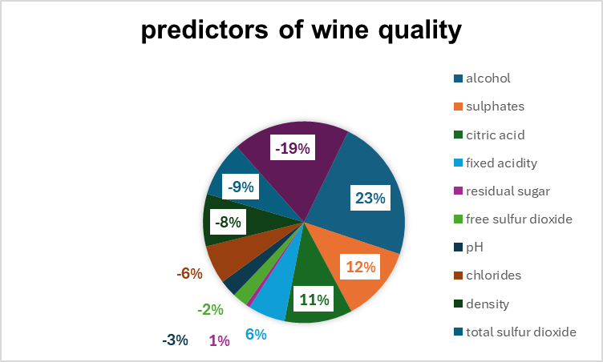
Conclusion
To conclude, here are the main takeaways from the analysis.
Alcohol content is a strong predictor of wine quality, higher alcohol content, higher quality ratings.
Sulphates and citric acid also positively play an importance role in enhancing wine flavors and preservation.
Volatile acidity negatively impacts wine quality, which is higher levels of volatile acidity leads to lower quality ratings.
Next Step
Continuous Monitoring: Implement a system for regular monitoring of wine samples to ensure that physicochemical properties remain within optimal ranges for high quality.
Develop strategies to optimize production processes based on these findings, ensuring that the winery can consistently produce high-quality wines.

